Slide 1
An Introduction to Web Components
WC
Dan Hamblin
December 2021

Slide 2

A background understanding of the following topics will likely help, but a ‘quick’ introduction of each will be presented…
Pre-Requisites
HTML
JavaScript
CSS
SVG
VS Code
There’s a lot to get through; please ask questions as the session progresses but we must be mindful of time!

Slide 3
Agenda
A Bit of History
Hands On
Future Reading…
Questions

Slide 4



Components
A Bit of History
Re-usable ‘Components’ have been around for a while – buttons, check-boxes, menus, drop-down selections; they can all be considered as components (Windows, Web, iPhone, Android – they all use them!).
Web browsers have a library of the ‘basic’ page building blocks.
If you want to build more complex components, it’s difficult and not consistent (and very likely to be hard to maintain).
For the web, lots of libraries have been developed to address this problem, here are some common libraries used across the web…

Slide 5

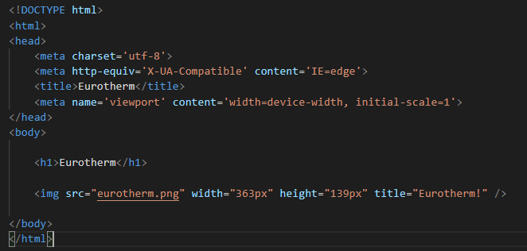
What is HTML…
HTML stands for Hyper Text Markup Language. It describes the structure of a Web page and consists of a series of elements that tell the browser how to display the content.
HTML
body
Heading 1
Image
STEP-01
Notes:
https://www.w3schools.com/html/html_intro.asp
Elements such as Buttons, Images, Videos etc
Properties / Attributes
Image refers to an external image (or asset) to display; the src attribute tell the browser where to get the image from…

Slide 6
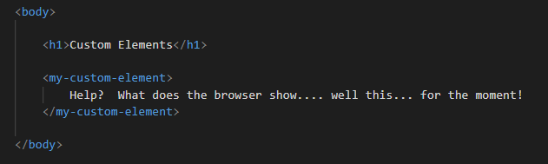
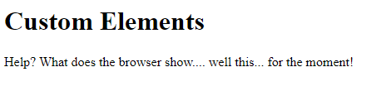
Web Components are a set of W3C standards to make self-contained components…
Web Components
…custom HTML-elements with their own properties and methods.
i
STEP-02
Notes:
Standards are still being developed!
Google Chrome is probably the best browser to support them at present
If a browser doesn’t recognize a tag, it ignores it an attempts to render what’s within it
Information Tag
The message is displayed when
1. The browser does not support custom elements, or,
2. The customer element (Web Component) has not yet loaded!
Homework – how to detect?

Slide 7
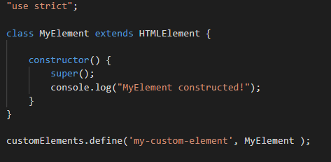
Hooking things up with some JavaScript…
Web Components
my-element.js
STEP-03
Notes:
It’s hooked up, but the message “Your browser does not support custom elements :-(“ is still displayed!!
Why? Well, we haven’t told the browser what to render yet….

Slide 8
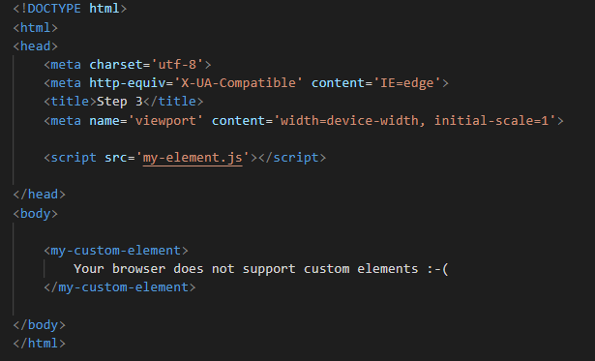
Don’t forget to reference the JavaScript file in the HTML…
index.html
Web Components
STEP-03
Notes:
Looking at the console we can see that something is happening, but the browser is still showing our message….

Slide 9
Web Component Life-Cycle Hooks:
Web Components
connectedCallback – invoked when the custom element is appended into a document.
disconnectCallback – invoked when the custom element is disconnected from the document.
adoptedCallback – invoked each time the custom element is moved to a new document
attributeChangedCallback – Invoked each time one of the custom element's attributes is added, removed, or changed.
STEP-03
Notes:
Standards are still being developed!
Google Chrome is probably the best browser to support them at present

Slide 10
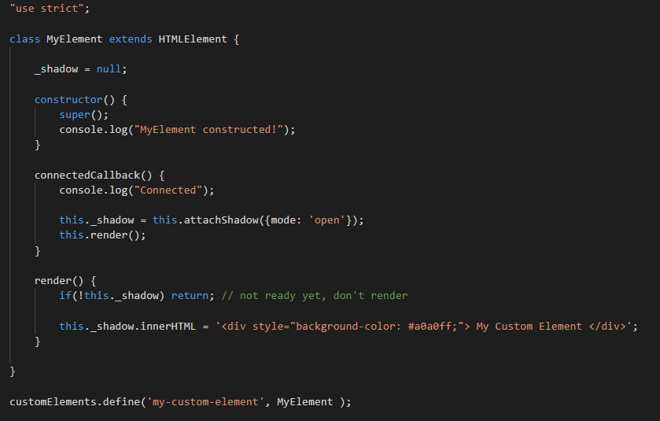
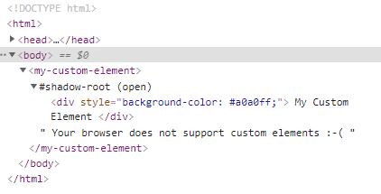
connectedCallback
Web Components
i
i
STEP-04
Notes:
Shadow DOM: a DOM within a DOM
Good explanation here: https://glazkov.com/2011/01/14/what-the-heck-is-shadow-dom/
Attaching a Shadow Domn; two modes –
Open: Elements are accessible from JavaScript outside of the root.
Closed: Denies access to the node(s) of a closed shadow root
Information Point 1
Defining a DOM using strings is generally frowned upon and can become quite un-manageable with complexity. There are many templating techniques and frameworks that can be used but are out of scope of this Know How.
Information Point 2:
To see the shadow DOM, in some browsers, you may have to enable this option!

Slide 11
SVG – Scalable Vector Graphics
Let’s make the Web Component a bit more seasonal…
Web Components
POLYGON
50, 0
70, 20
60, 20
80, 40
70, 40
90, 60
80, 60
100, 80
0, 80
20, 60
10, 60
30, 40
20, 40
40, 20
30, 20
50, 0
0
10
20
30
40
50
60
70
80
90
100
110
120
130
140
150
1
10
20
…
2
30
40
50
60
70
80
90
100
110
RECTANGLE
Top Left = 40, 80
Width = 20
Height = 20
120
130
140
150
Notes:
Standards are still being developed!
Google Chrome is probably the best browser to support them at present

Slide 12
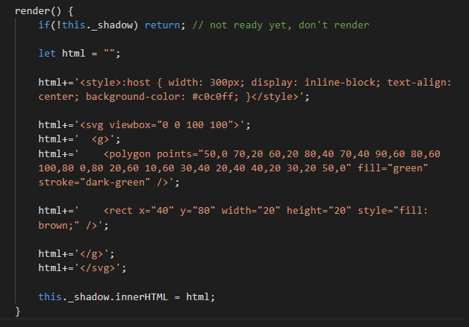

Web Components
STEP-05
Notes:
Standards are still being developed!
Google Chrome is probably the best browser to support them at present

Slide 13

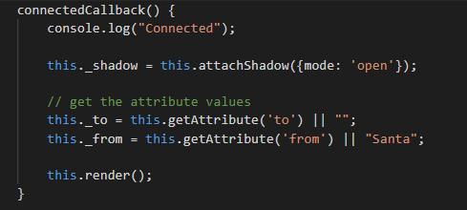
Adding a Personal Greeting
index.html
Web Components
my-element.js
STEP-06
Notes:
Standards are still being developed!
Google Chrome is probably the best browser to support them at present

Slide 14
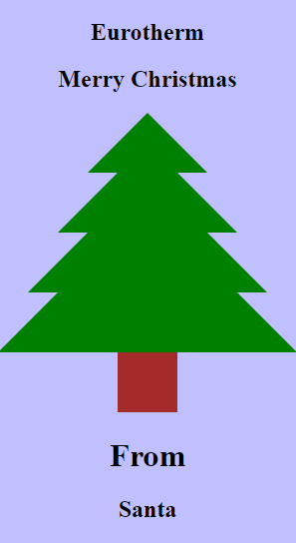
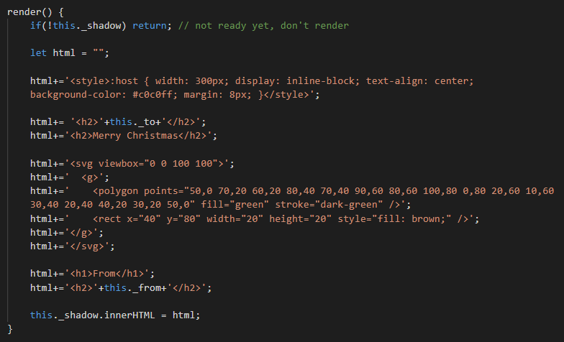
Adding a Personal Greeting
Web Components
STEP-06
Notes:
Standards are still being developed!
Google Chrome is probably the best browser to support them at present

Slide 15

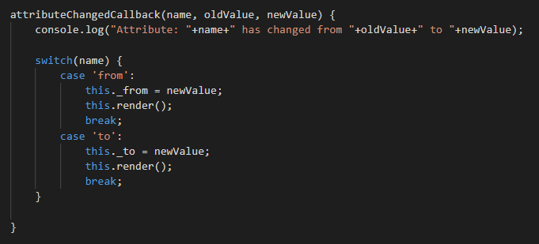

Dynamically Modifying Attributes 1
Web Components
STEP-07
Notes:
By directly editing the Html from the DevTools in the browser…
Add an image <img src=“snow-flake.png” /> after “Merry Christmas”
Change either the “to” or “from” attribute and watch what happens to the snow flake.

Slide 16
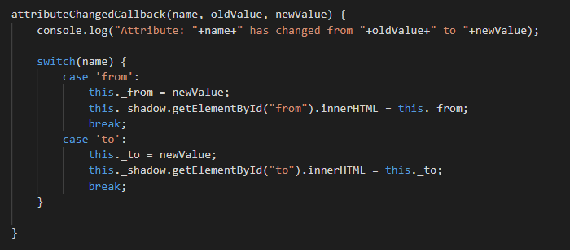
Dynamically Modifying Attributes 2
Web Components
id=“to”
i
attributeChangedCallback before the shadow DOM!
id=“from”
STEP-08
Notes:
attributeChangedCallback will fire before the shadow dom has been created!!

Slide 17
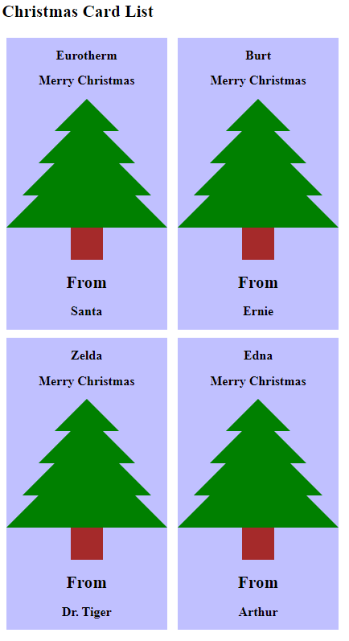
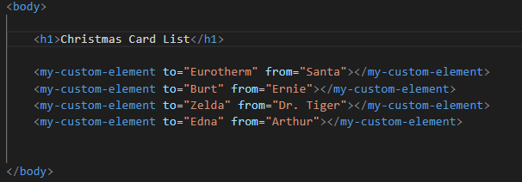
Don’t Forget, It’s Reusable!
Web Components
index.html
STEP-09
Notes:
Standards are still being developed!
Google Chrome is probably the best browser to support them at present

Slide 18

Let it snow…
Web Components
STEP-09
Notes:
Let it snow!

Slide 19
We’ve Only Touched the Surface!
Future Topics
It’s been a brief introduction to Web Components, and we’ve only touched the surface. There are some great HTML5 technologies that complement Web Components perfectly; unfortunately we’ve not had time to cover them. For future topics (or reading)…
Using Templates and Slots
https://developer.mozilla.org/en-US/docs/Web/Web_Components/Using_templates_and_slots
Styling
https://css-tricks.com/styling-a-web-component/
Libraries
https://www.webcomponents.org/libraries
Notes:
Standards are still being developed!
Google Chrome is probably the best browser to support them at present

Slide 20
Future Reading
All the steps in this Know How are available on GitHub:
https://github.com/morphfx/wc-introduction/
Web Components – look what’s available…
https://www.webcomponents.org/
W3Schools – a great source for learning about the web…
https://www.w3schools.com/
Notes:
Standards are still being developed!
Google Chrome is probably the best browser to support them at present

Slide 21
QU
Questions
Notes:
Standards are still being developed!
Google Chrome is probably the best browser to support them at present

Slide 22
Notes:
Standards are still being developed!
Google Chrome is probably the best browser to support them at present

